Slide 1
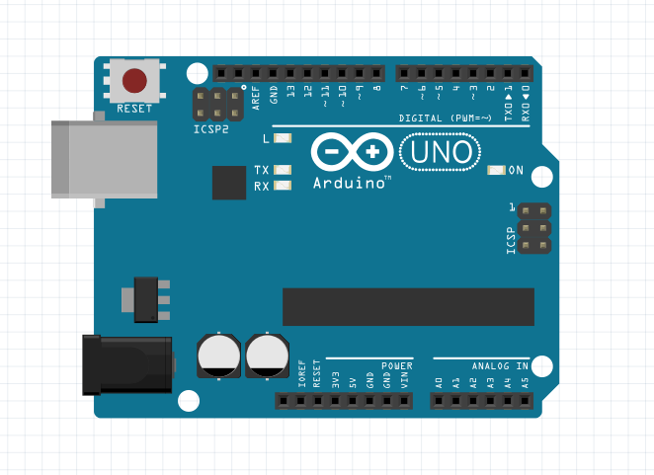
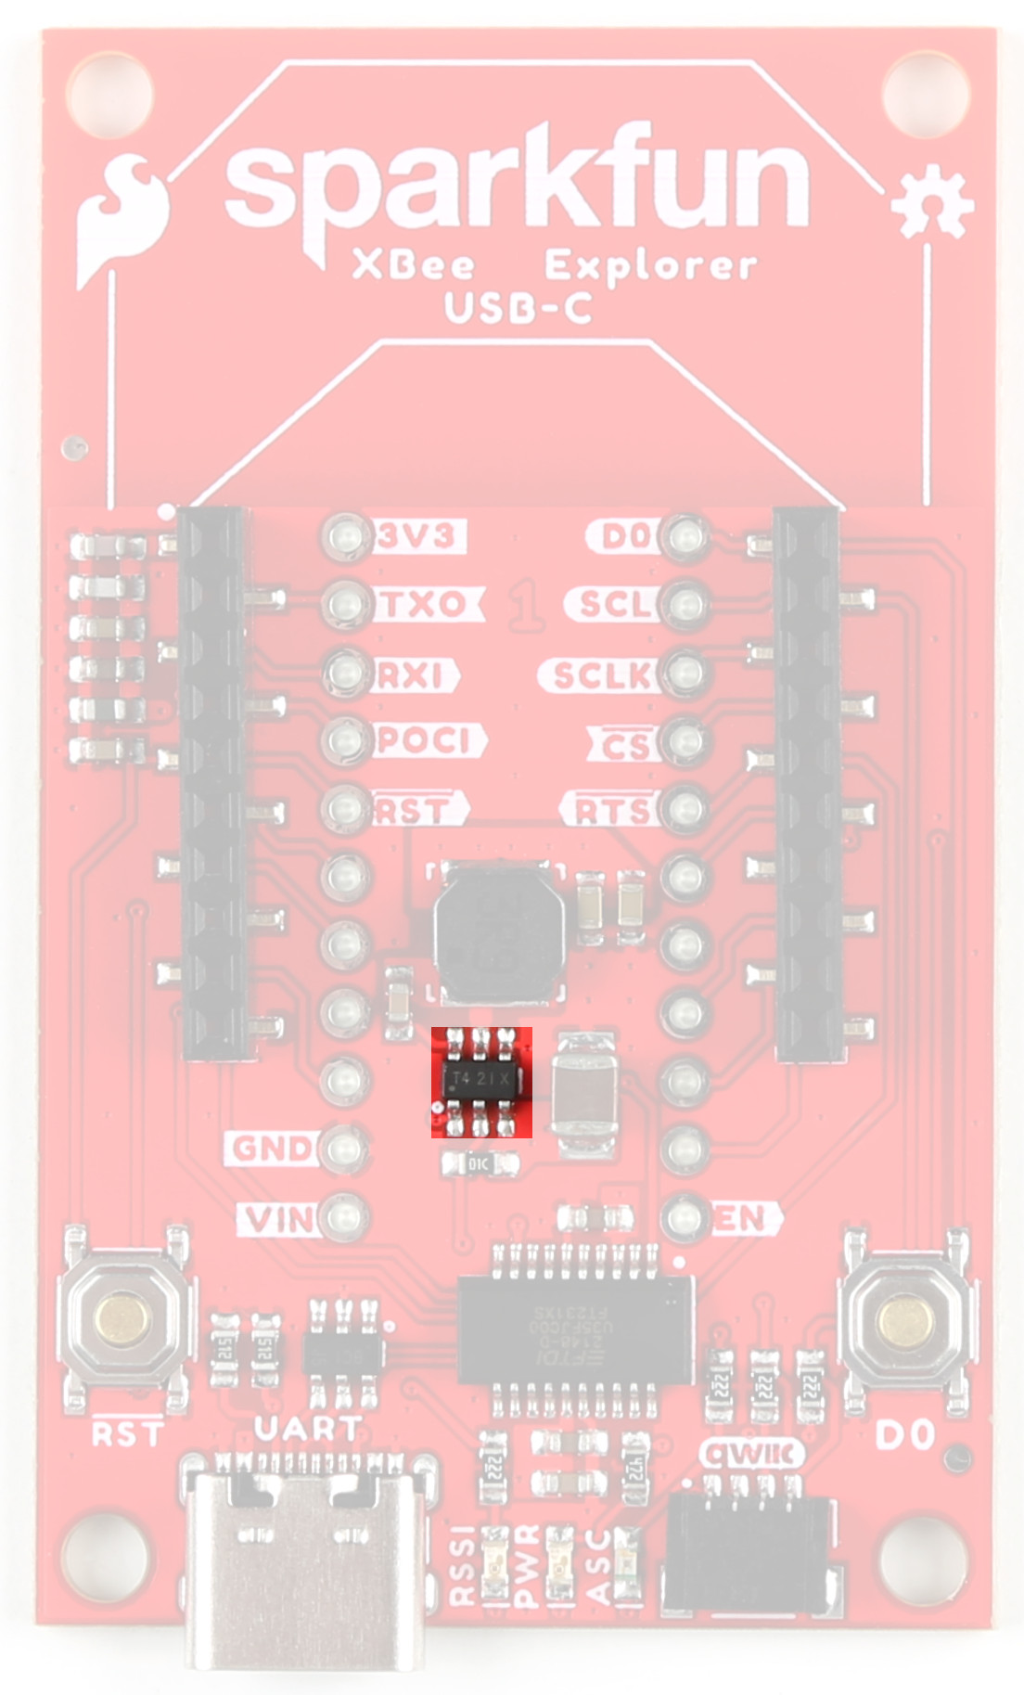

Smart Parking Lot Monitoring
CMOV (UbiComp/IoT) — Arduino + XBee + HTTP Cloud Ingestion
Team
Tomás · Ilias · Melissa
Key stack
• Edge: Arduino UNO + MB1010 (analog)
• Wireless: XBee (ZigBee, transparent UART)
• Gateway: Java (jSerialComm)
• Cloud: ThingSpeak (HTTP POST)
Universidade Fernando Pessoa — Master’s in Informatics (Mobile Computing)
Notes:
[Sources] - Arduino UNO image (CC BY-SA 4.0): https://upload.wikimedia.org/wikipedia/commons/5/59/Arduino_uno.png - XBee Explorer image (SparkFun): https://docs.sparkfun.com/SparkFun_Digi_XBee_Explorer_USB-C/assets/img/22043-SparkFun-XBee-Explorer-USB-C-BuckConverter.jpg - ThingSpeak logo (Wikimedia Commons): https://upload.wikimedia.org/wikipedia/commons/3/38/Thingspeak_logo_white.png [/Sources]

Slide 2
Goals & Requirements (CMOV)
What the protocol asks for
What we implemented (CMOV)
Develop edge nodes using Arduino+XBee and/or LoPy4+WiFi
Configure wireless communication and implement a gateway
Communicate to a broker/backend via MQTT or HTTP
Implement cloud ingestion, storage and (optionally) actuation back to edge
Document architecture, interconnections and communications
Edge node detects occupancy (state-change events)
ZigBee/XBee wireless link in transparent serial mode
PC gateway (Java) parses frames and uploads via HTTP
ThingSpeak cloud ingestion + visualization
Gateway queue to respect ThingSpeak rate limits
CMOV deliverable focus: Edge → Gateway (Fog) → Cloud ingestion
Notes:
[Sources] - Course protocol / project statement (provided by the instructor): ProjectCMOV_PAMO_202526.pdf (UFP CMOV/PAMO 2025/26) [/Sources]

Slide 3
Architecture Overview
Layered SEMAS-style pipeline: sensing at the edge, aggregation at the gateway, storage/visualization in the cloud.
EDGE
GATEWAY (FOG)
CLOUD
ThingSpeak
HTTP ingestion
Fields: occupied, cm, ts
Arduino UNO
MB1010 sensor (A0)
State-change frames
PC + XBee Coordinator (USB)
Java: read serial → parse frames
HTTP client (rate-limited)
ZigBee/XBee wireless link — transparent UART @ 9600 bps — same PAN ID
Notes:
[Sources] - XBee roles (coordinator + routers/end devices in Zigbee): https://docs.digi.com//resources/documentation/digidocs/90001942-13/tasks/t_configure_zigbee_modules.htm - ThingSpeak overview (IoT analytics platform): https://thingspeak.mathworks.com/ - Arduino UNO image (CC BY-SA 4.0): https://upload.wikimedia.org/wikipedia/commons/5/59/Arduino_uno.png - XBee Explorer image (SparkFun): https://docs.sparkfun.com/SparkFun_Digi_XBee_Explorer_USB-C/assets/img/22043-SparkFun-XBee-Explorer-USB-C-BuckConverter.jpg - ThingSpeak logo (Wikimedia Commons): https://upload.wikimedia.org/wikipedia/commons/3/38/Thingspeak_logo_white.png [/Sources]

Slide 4
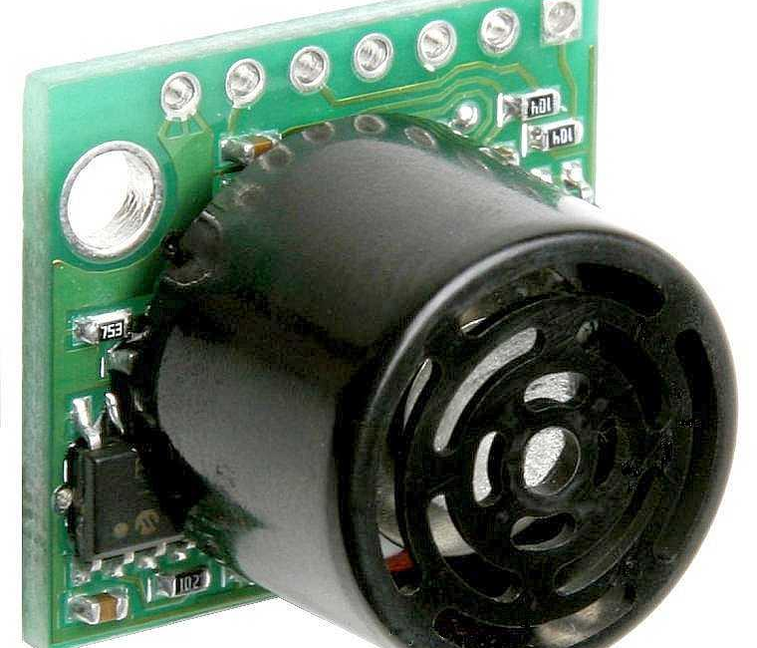
Edge Node: Sensing + Local Decision
Hardware
Occupancy logic (on Arduino)
Median of 5 ADC samples to reduce noise
Convert distance (cm) from analog reading
Hysteresis thresholds (enter / exit) to avoid flickering
Stability counter (N consistent reads) before confirming a change
Send telemetry only on state change: spot1=0/1, cm=NN
MB1010 analog OUT → A0
Vcc=5V, GND=GND
XBee Router AT (shield) → serial bridge
Example frame: spot1=1,cm=33;
Notes:
[Sources] - MB1010 outputs and analog scale (Vcc/512 per inch at 5V): https://www.pololu.com/product/726/ - Arduino UNO image (CC BY-SA 4.0): https://upload.wikimedia.org/wikipedia/commons/5/59/Arduino_uno.png - MB1010 product photo (Pololu): https://a.pololu-files.com/picture/0J174.1200.jpg [/Sources]

Slide 5
Wireless Link: XBee Configuration
Two XBee PRO S2B modules form a simple ZigBee network:
Coordinator (Gateway side)
Router / End Device (Arduino side)
Firmware: ZigBee Coordinator AT
Connected via USB Explorer (FT232R) to the PC
Same PAN ID as router
Optionally set NI=COORD for easier identification
Firmware: ZigBee Router AT (or End Device AT)
Same PAN ID as coordinator
Destination address to reach coordinator:
• Simplest: DH=0 and DL=0 (address coordinator)
• Or: DH=SH(coordinator) and DL=SL(coordinator)
Tip: CH (Operating Channel) is read-only — it is chosen automatically after joining the PAN.
Notes:
[Sources] - Digi guide (same PAN ID; one coordinator; DH/DL=0 to address coordinator): https://docs.digi.com//resources/documentation/digidocs/90001942-13/tasks/t_configure_zigbee_modules.htm [/Sources]

Slide 6
Gateway: Serial → Parse → HTTP (Java)
Serial ingestion
HTTP forwarding (ThingSpeak)
Detect FT232R/XBee Explorer COM port
Open UART: 9600 bps, 8N1, non-blocking reads
Buffer bytes until “;” delimiter
Parse key-value pairs: spot1, cm
Build POST body (x-www-form-urlencoded)
field1=occupied, field2=cm, field3=timestamp
ThingSpeak free tier: min 15 s between updates
Coalescing queue: store latest event and send when allowed
Why queue?
Avoid “rate limited” skips while preserving the latest state.
Notes:
[Sources] - ThingSpeak free option update interval limit (15 seconds): https://thingspeak.mathworks.com/pages/license_faq - ThingSpeak documentation (rate limits and API addresses): https://se.mathworks.com/help/thingspeak/channel-control.html [/Sources]

Slide 7
Cloud Backend: ThingSpeak
ThingSpeak provides a lightweight way to ingest, store and visualize IoT data using HTTP (or MQTT).
Channel mapping used in this project
Operational constraints
Free tier: minimum 15 s per update per channel
Read requests are not rate-limited (per docs)
Easy dashboards for demo & validation
field1 → occupied (0/1)
field2 → distance in cm
field3 → timestamp (epoch seconds)
Notes:
[Sources] - ThingSpeak overview: https://thingspeak.mathworks.com/ - ThingSpeak API rate limits (15s free tier; reads not limited): https://se.mathworks.com/help/thingspeak/channel-control.html - ThingSpeak logo (Wikimedia Commons): https://upload.wikimedia.org/wikipedia/commons/3/38/Thingspeak_logo_white.png [/Sources]

Slide 8
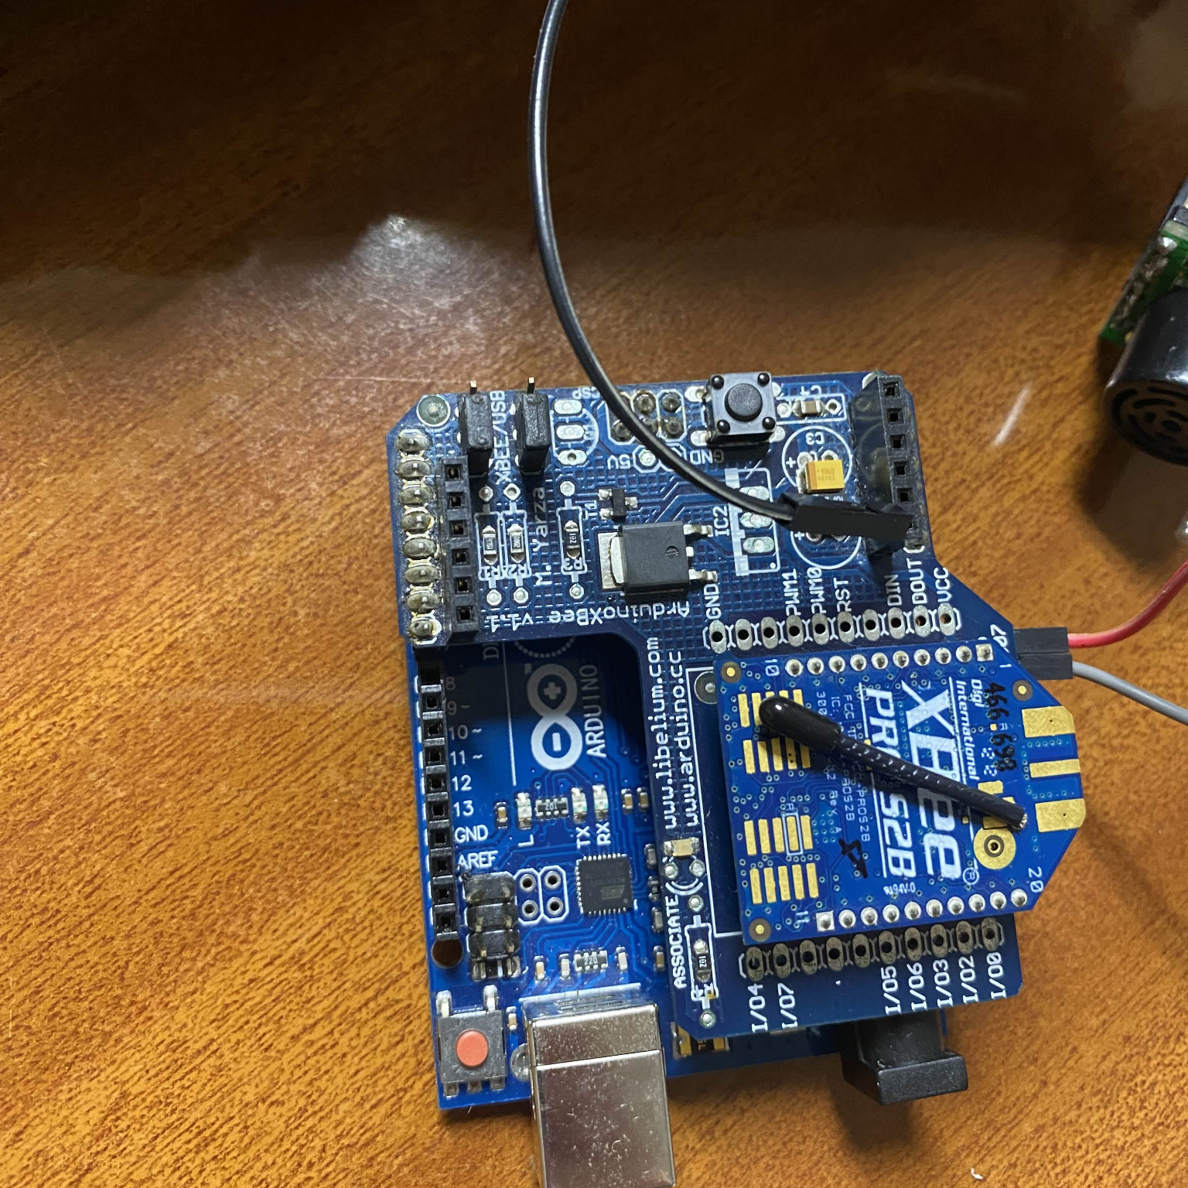
Demo & Validation
Observed end-to-end behavior
Prototype hardware (lab)
Arduino detects transitions using hysteresis + stability counter
Only publishes when the state changes (free ↔ occupied)
Gateway parses frames and uploads to ThingSpeak via HTTP
Queue avoids skipped updates due to the 15s constraint
[Example logs]
spot1=1,cm=33;
spot1=0,cm=553;
User-provided photo: Arduino + XBee shield + wiring.
Notes:
[Sources] - User-provided photo (conversation attachment) [/Sources]

Slide 9
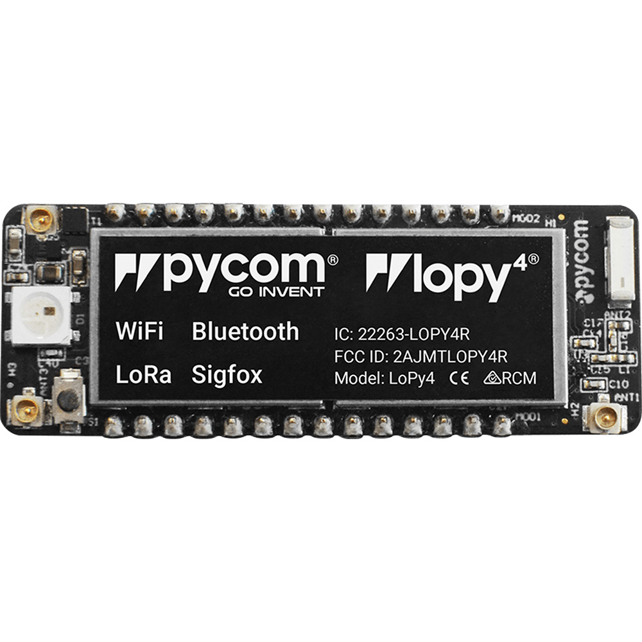
Future Work
Next steps
LoPy4 concept
Replace the PC gateway with a LoPy4 (WiFi) to remove the laptop dependency
Connect XBee Coordinator to LoPy4 via a suitable serial interface/adapter
Run frame parsing + HTTP client on LoPy4 (MicroPython)
Add cloud → gateway → edge actuation (LEDs, barrier control)
Scale to multiple parking spots (IDs, mapping, dashboards)
Goal: a small always-on gateway
WiFi uplink → ThingSpeak
No PC required
Notes:
[Sources] - LoPy4 capabilities (WiFi/Bluetooth/LoRa/Sigfox): https://uk.rs-online.com/web/p/communication-wireless-development-tools/1628047 - LoPy4 image: https://assets.rs-online.com/image/upload/v1666738633/72059655.jpg [/Sources]

